Slide 1
Summary of the factors that influence summary rutines

Slide 2
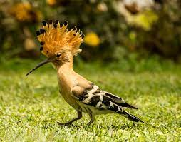
Hoopoe
Basic Needs | Individual Needs | Habitat condition
Finding food and water | Large insects | They require the habitat to have scattered trees or cliffs
Finding or building a shelter | Hoopoes like to nest in vertical surfaces with cavities, for example cliffs, trees or even walls.
Finding mates | The males woo their mates by singing to them and by fighting with competitors.
Producing young | Finding mates

Slide 3
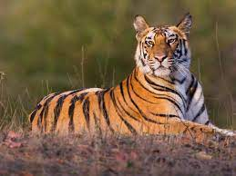
Tigers
Basic Needs | Individual Needs | Habitat condition
Finding food and water | Meat | Savana
Finding or building a shelter | Mountains
Finding mates | Finding mates
Producing young | Producing young

Slide 4
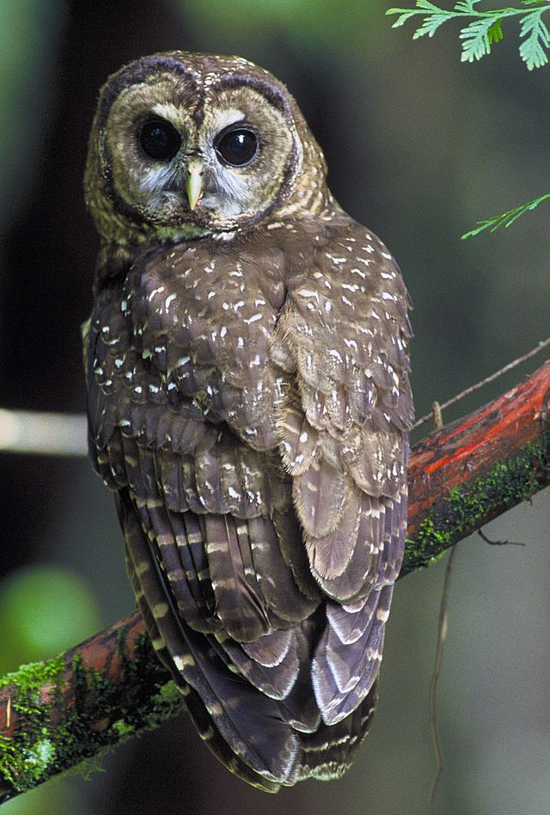
Owl
Basic Needs | Individual Needs | Habitat condition
Finding food and water | Meat | Forests
Finding or building a shelter | Tree trunks
Finding mates | Finding mates
Producing young | Producing young

